Slide 1
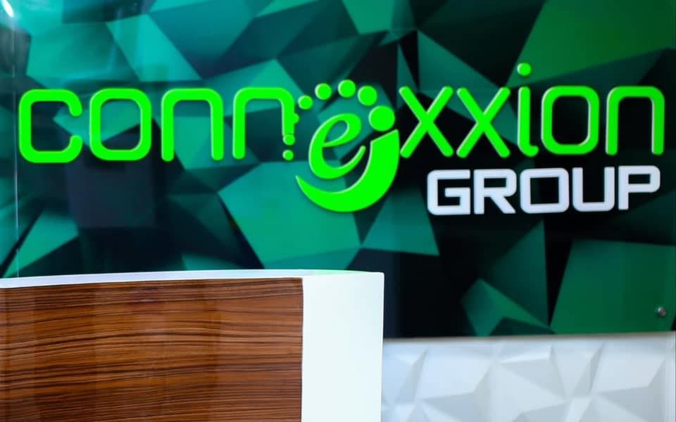
CNX247 ERP(Enterprise Resource Planning) Solution.
contact@connexxiongroup.com
2A Iller Crescent, Maitama, Abuja
https://www.connexxiongroup.com
+234(0)901-640-0000

Slide 2
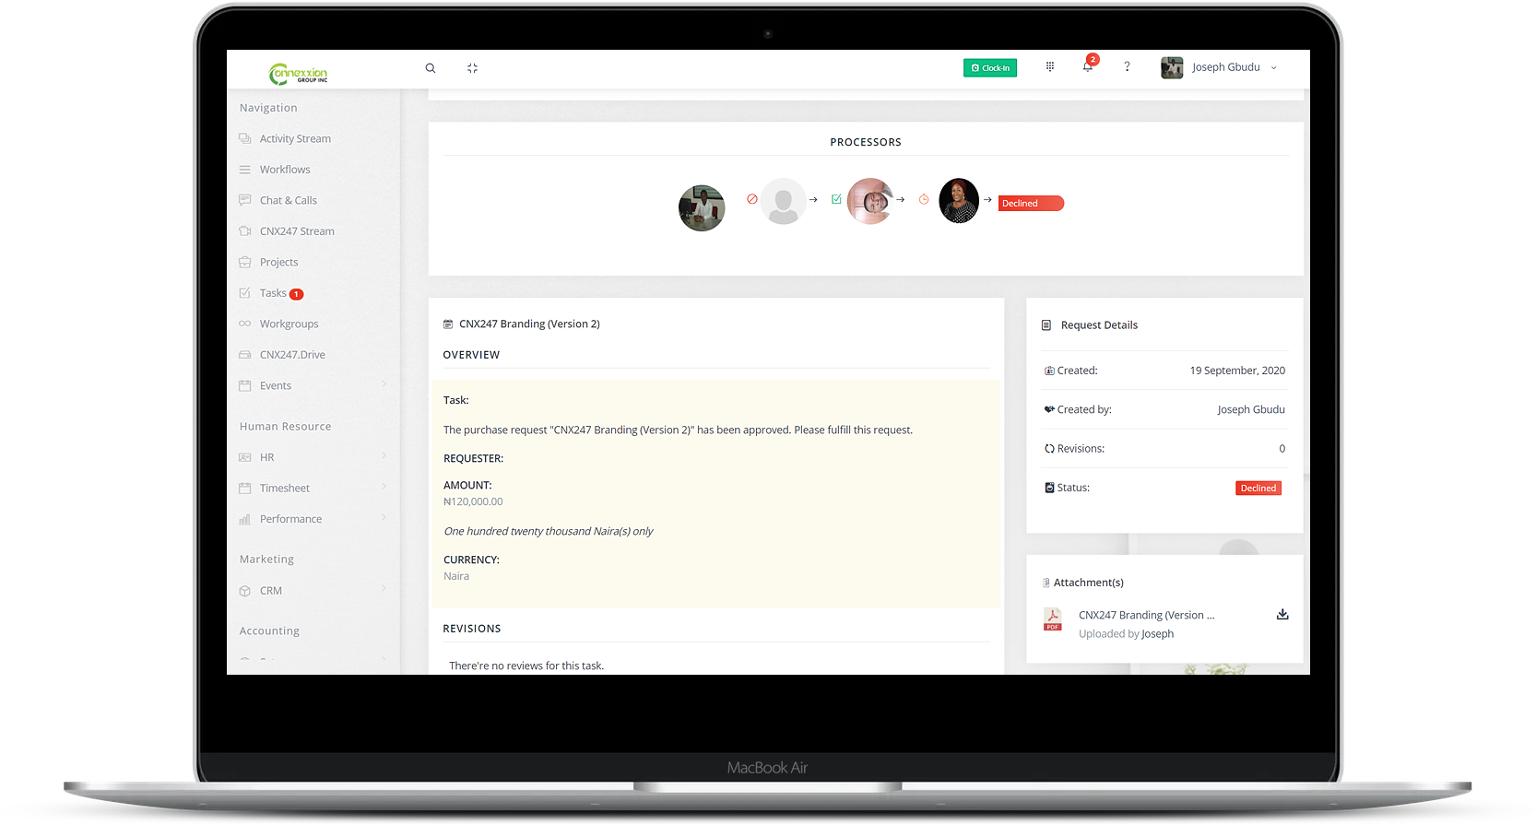
WHAT THIS IS..
“CNX247 among other benefits is a flexible ERP solution that improves reporting and planning.”

Slide 3

INTRODUCTION
An ERP software is a tool that centralizes a company’s database of information, automates routine tasks and simplifies business processes.
ERP software is unique because it touches many if not all of the different aspects of a business. It’s an end-to-end solution with features such as:
Accounting
Task
Workflow
Human Resource
Projects
Workgroup
Live Streaming
Customer Relationship Management (CRM)

Slide 4
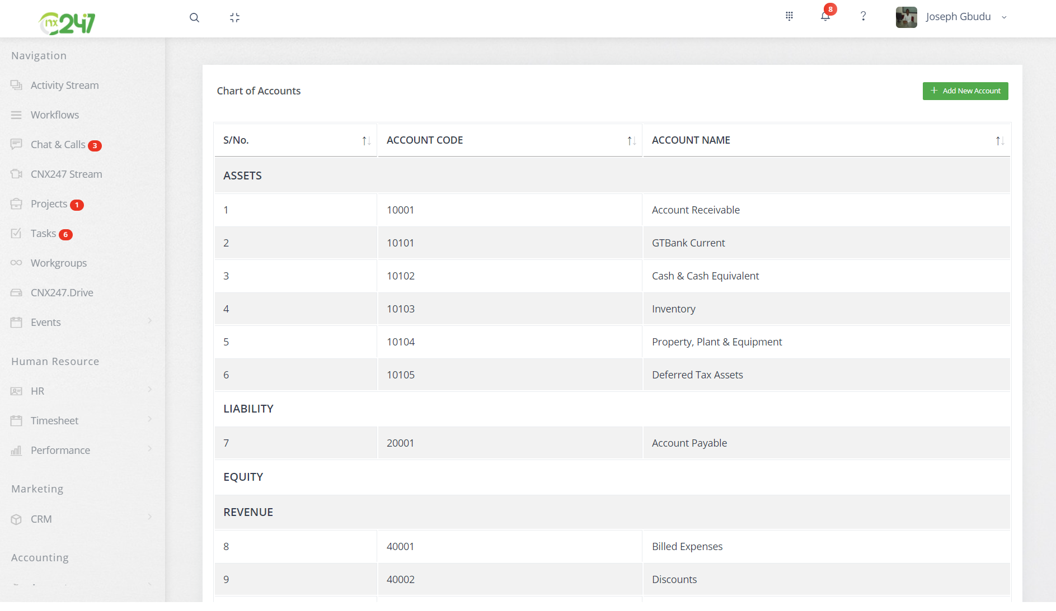
Accounting
The accounting module of CNX247 comes with features such a Chart of accounts, Journal voucher, vendors, customers, etc.
It also gives you the privilege to generate reports such as:
Trial balance
Balance sheet
Income statement

Slide 5
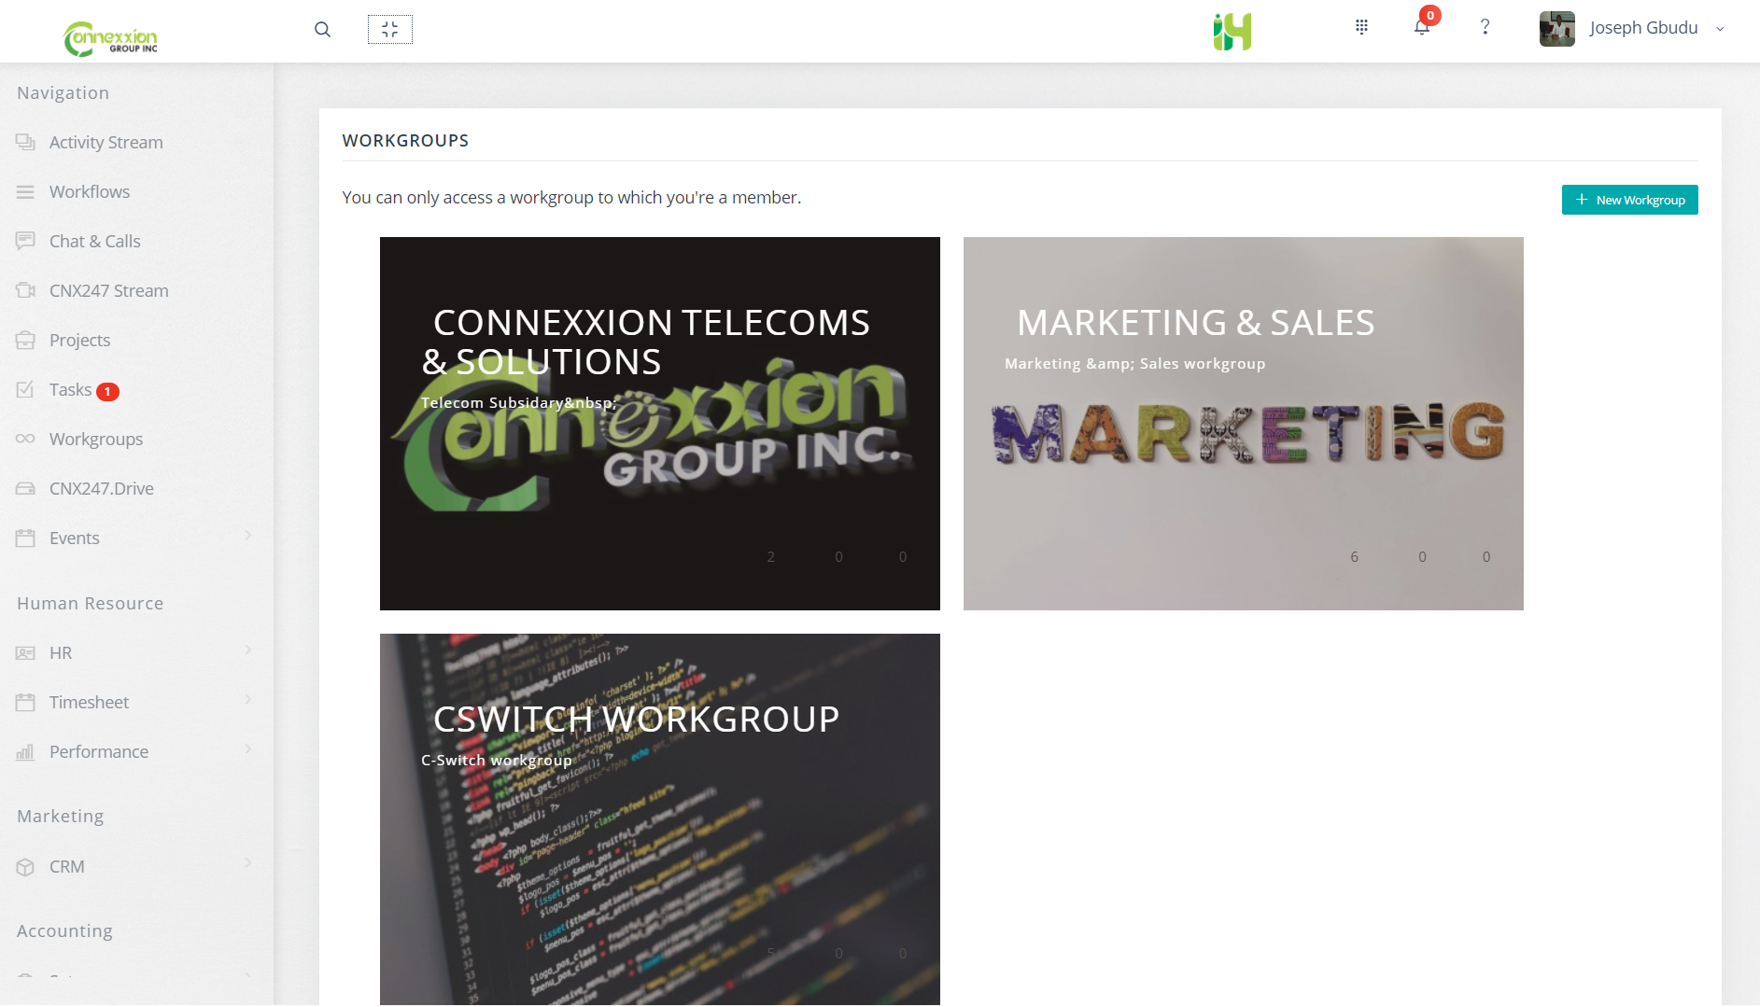
Workgroup
Bring your team to collaborate on same project within a workgroup. Share resources, assign task and much more.
With restricted access, only members of a workgroup are allowed to access it’s content.

Slide 6
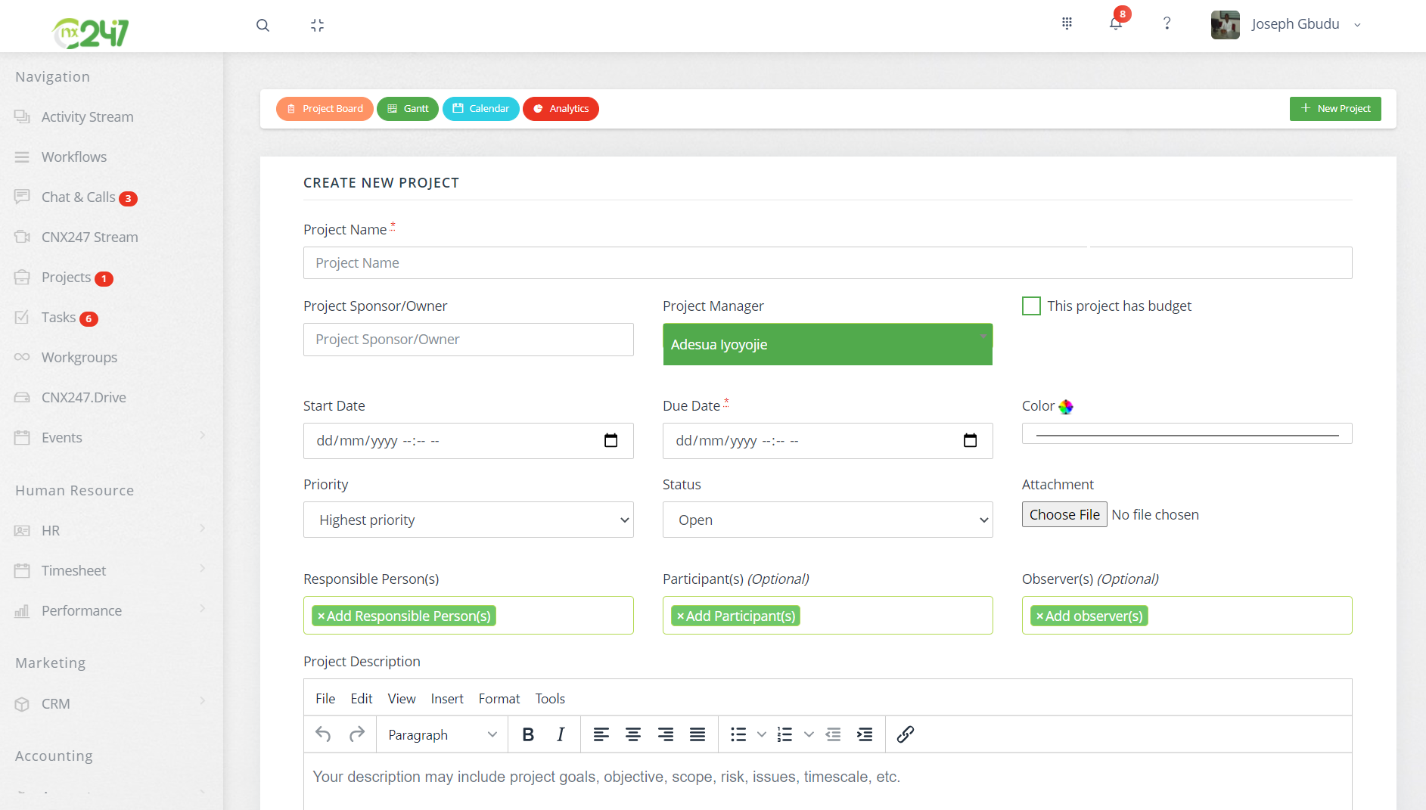
Project
CNX247 allows you total access to every important process in project creation.
Create a new project by assigning different roles to the various persons involved, track income/expenses, add milestone and much more.

Slide 7
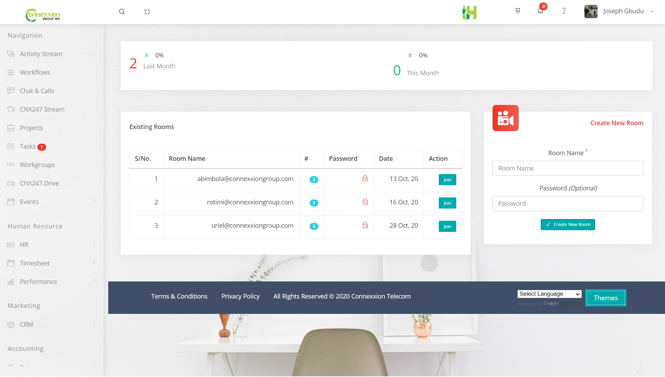
CNX247Stream
Collaboration is an essential part of a thriving business.
In addition to workgroups, CNX247Stream enables organizations to hold virtual meetings.
These meetings could be private or public.

Slide 8
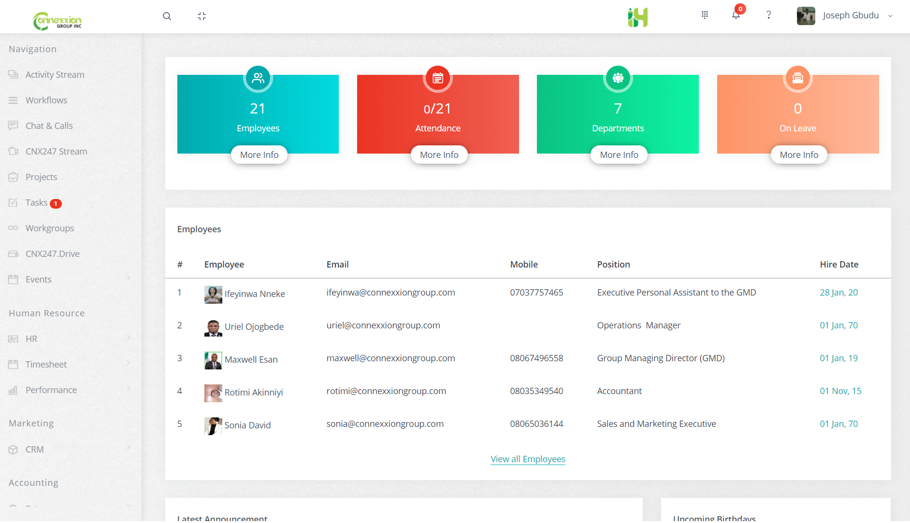
Human Resource (HR)
The HR module will make it easy for you to find, analyze and report on the people data that matters most to each function in your organization.
Make better decisions
Have an archive of your workforce.

Slide 9



OUR OTHER PRODUCTS
CNX Secure
Functionalities of our AXIS IP-based video surveillance system using progressive scan video cameras provide superior, crystal clear image even with fast motion in the scene.
CNX Smart Living
Connexxion designs intelligent home automation systems with the focus on simplicity, peace of mind and comfort.
CNX Presence
CNX Presence covers areas such as: Web Conferencing, Screen Sharing, Online Meetings, Instant Messaging, Web Seminars, Web-casting, Chat software, Screen-casting, Micro-blogging.
iHumane
IHUMANE is a customizable and comprehensive software that brings organization and effectiveness to the full range of Human Resource functions and responsibilities.
CNXSchool Pro
SchoolPRO is a software designed for Students, Parents and administrative staff (Teachers, Principal and accountant) for effective school resource management.

Slide 10

THANK YOU!
contact@connexxiongroup.com
https://www.connexxiongroup.com
+234(0)901-640-0000
2A Iller Crescent, Maitama, Abuja

